Slide 1
Special Course in Software Engineering ‘24
MINI-PROJECT PRESENTATION
GROUP NO. 15

Slide 2
Group Introduction

Slide 3
Group members and their contribution
Member Name | Contribution to the Mini-project
Zhang Zihan | 1~5exercises, the writing of analysiscode and main,ppt making, leader
Chang Da | mainly 4 and 5exercise, the writing of analysiscode
Jiang Zhongjie | mainly 2 and 3 exercise,the writing of main, test the code

Slide 4
Dataset

Slide 5
Dataset introduction
Dataset name: ParisHousing.csv
Brief description: (which contains detailed information about various houses in Paris. It includes both numeric and categorical data such as the size of the house in square meters, the number of rooms, the number of previous owners, and the price of the house. The dataset provides a comprehensive view of housing features like whether the house has a basement, an attic, or a garage, and other factors that may influence house prices.
Variable | Type of data | Mean / Median / Mode | Kurtosis | Skewness | Normality
price | Ratio | 4993447.53 | -1.19 | -0.01 | normal
hasSrorageRoom | Nominal | 0.50 | -2.00 | -0.01 | not normal
hasStormProtector | Nominal | 0.50 | -2.00 | 0.00 | not normal
category | Nominal | Basic | NA | NA | not normal
cityPartRange | Ordinal | 5.51 | -1.23 | -0.00 | not normal
squareMeters | Ratio | 49870.13 | -1.19 | -0.01 | normal
TheYearRange | Ordinal | after 2011 | NA | NA | not normal

Slide 6
Dataset introduction
Variable | Type of data | Mean / Median / Mode | Kurtosis | Skewness | Normality
numberofRooms | Ratio | 49870.13 | -1.19 | -0.01 | normal
floors | Ratio | 50.28 | -1.20 | 0.01 | normal
cityCode | Ratio | 50225.49 | -1.22 | -0.02 | normal
numPrevOwners | Ordinal | 5.52 | -1.21 | 0.00 | not normal
made | Ratio | 2005.49 | -1.22 | -0.01 | normal
isNewBuilt | Norminal | 0.50 | -2.00 | 0.00 | not normal

Slide 7
Dataset introduction
Variable | Type of data | Mean / Median / Mode | Kurtosis | Skewness | Normality
attic | Ratio | 5028.01 | -1.21 | -0.02 | normal
garage | Ratio | 553.12 | -1.21 | -0.02 | normal
hasGuestRoom | Ratio | 4.99 | -1.23 | 0.01 | not normal
PoolAndYard | Nominal | has pool and has yard | NA | NA | not normal
basement | Ratio | 5033.10 | -1.18 | -0.03 | normal

Slide 8
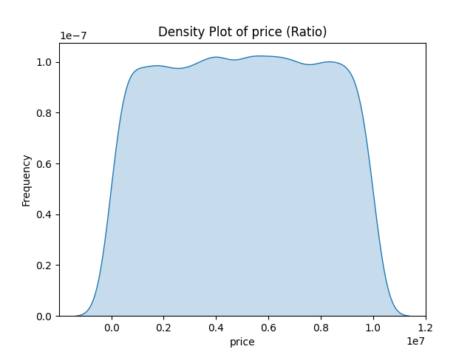
(price) distribution
Distribution Shape: The density plot shows that the distribution of house prices is relatively flat, with no prominent peaks. This indicates that prices are evenly distributed across the dataset, with no particular price range being overly concentrated.
Extremes: The price range appears smooth at both ends of the plot, suggesting there are no significant outliers (i.e., no extreme high or low prices).
Frequency: The frequency variation across the entire price range is minimal, indicating that house prices are fairly evenly distributed throughout the dataset.
Summary: This plot illustrates the overall distribution of house prices, showing that prices are spread relatively evenly across the sample, without a specific price range standing out.

Slide 9
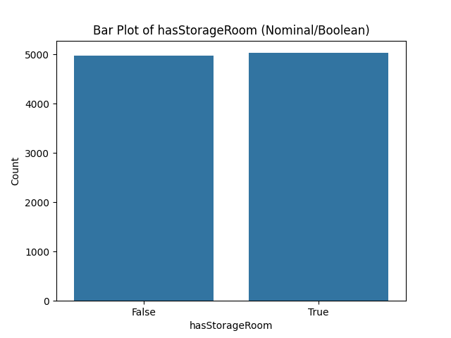
(hasSrorageRoom) distribution
Distribution Shape: The bar plot shows the distribution of the variable "hasStorageRoom," which is a nominal (boolean) variable. The two bars represent the counts of houses that have a storage room (True) and those that do not (False). The heights of the bars are nearly identical, indicating an almost equal distribution between houses with and without a storage room.
Extremes: There are no extreme values or outliers, as this is a categorical variable with two options.
Frequency: The counts for both True and False are nearly the same, showing that the presence of a storage room is evenly distributed in the dataset.
Summary: This bar plot illustrates that there is a balanced distribution between houses with and without a storage room, with no significant difference in frequency.

Slide 10
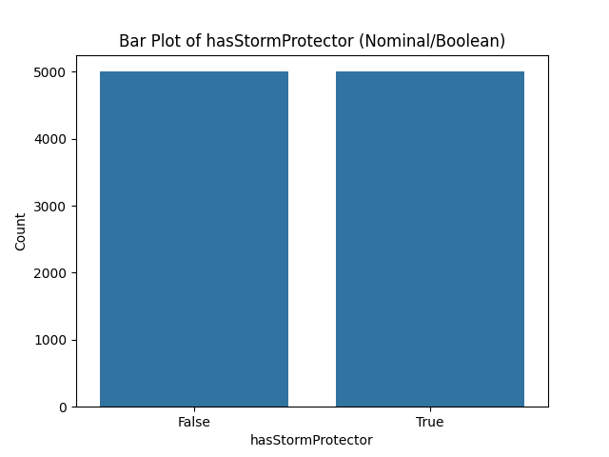
(hasStormProtector) distribution
Distribution Shape: This bar plot shows the distribution of the variable "hasStormProtector," which is also a nominal (boolean) variable. The two bars represent houses with storm protection (True) and without storm protection (False). Both bars are almost identical in height, suggesting an even distribution between houses with and without storm protection.
Extremes: There are no extreme values or outliers as this is a categorical variable.
Frequency: The counts for True and False categories are very close, showing that the presence of storm protection is evenly distributed across the dataset.
Summary: This bar plot indicates that houses with and without storm protection are almost equally distributed, with no noticeable imbalance between the two categories.

Slide 11
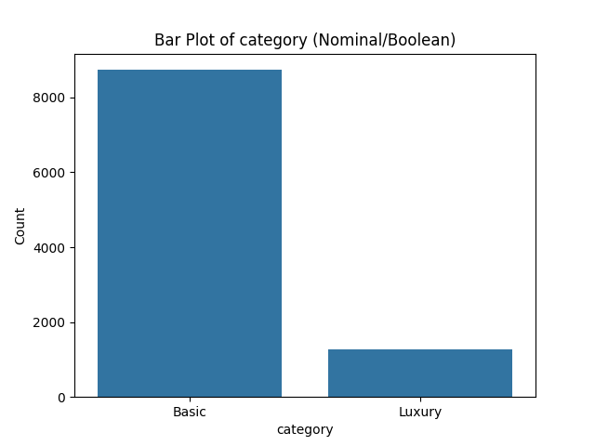
(category) distribution
Distribution Shape: This bar plot shows the distribution of the variable "category," which is a nominal variable representing the house categories (Basic and Luxury). The "Basic" category has a significantly higher count than the "Luxury" category.
Extremes: There are no extreme values as this is a categorical variable, but the difference in frequency between the two categories is quite large.
Frequency: The "Basic" category is far more common, with more than 8000 houses compared to less than 2000 houses in the "Luxury" category. This shows a strong imbalance between the two categories.
Summary: This bar plot indicates that the majority of houses in the dataset fall under the "Basic" category, with the "Luxury" category making up a small portion of the data.

Slide 12
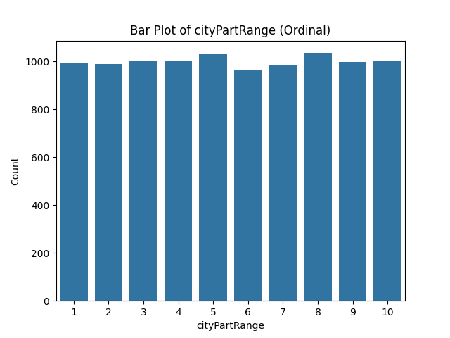
(cityPartRange) distribution
Distribution Shape: This bar plot shows the distribution of the "cityPartRange" variable, which is an ordinal variable representing different parts of the city. The distribution appears fairly uniform, with similar counts for all ranges.
Extremes: There are no significant outliers or extreme values. All parts of the city seem to have a similar number of houses.
Frequency: Each city part range has close to 1000 houses, with slight fluctuations but overall a balanced distribution across all categories.
Summary: The city is divided into 10 parts, and the distribution of houses across these parts is quite even, suggesting that no specific part of the city dominates in terms of housing numbers.

Slide 13
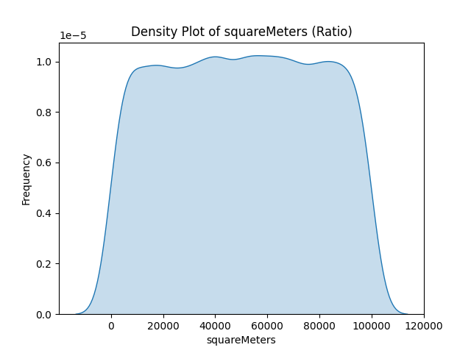
(squareMeters) distribution
Distribution Shape: The density plot of "squareMeters" shows a fairly uniform distribution, similar to a flat shape, without any significant peaks or valleys. This indicates that the house sizes are relatively evenly distributed across the dataset.
Extremes: There are no apparent extreme values (outliers), and the distribution appears to cover a broad range of house sizes, from smaller homes to very large ones, with smooth transitions at both ends.
Frequency: The frequency of house sizes is fairly consistent across the range, without any particular range dominating or showing a high concentration of data points.
Summary: The house sizes are evenly distributed, with no specific size range standing out in the dataset. This balanced distribution suggests that the dataset includes a variety of house sizes without any one size being overly represented.

Slide 14
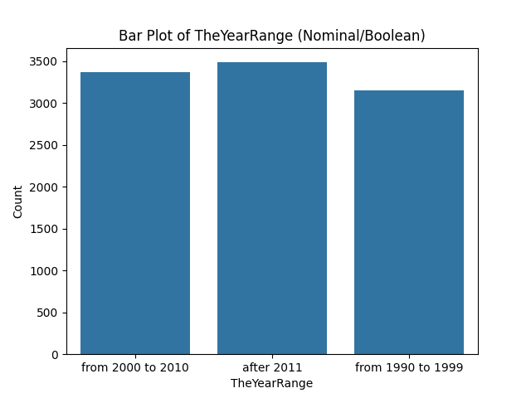
(TheYearRange) distribution
Distribution Shape: The bar plot of "TheYearRange" shows a fairly balanced distribution across the three ranges: "from 1990 to 1999," "from 2000 to 2010," and "after 2011." Each range has a similar count of houses, though "after 2011" has a slightly higher number compared to the other two.
Trend: The data suggests a slight increase in the number of houses built after 2011, possibly reflecting a trend towards newer constructions.
Summary: The distribution of houses built in these three periods is relatively even, indicating consistent levels of construction in each period, with a small uptick in more recent years.

Slide 15
Analysis

Slide 16
Hypothesis #1
Analysis Type: T-Test
Variables:
price (Ratio): The price of the house.
hasStorageRoom (Nominal): Whether the house has a storage room or not.
Null Hypothesis (H₀):
There is no significant difference in the average price between houses that have a storage room and those that do not.
Alternative Hypothesis (Hₐ):
There is a significant difference in the average price between houses that have a storage room and those that do not.)

Slide 17
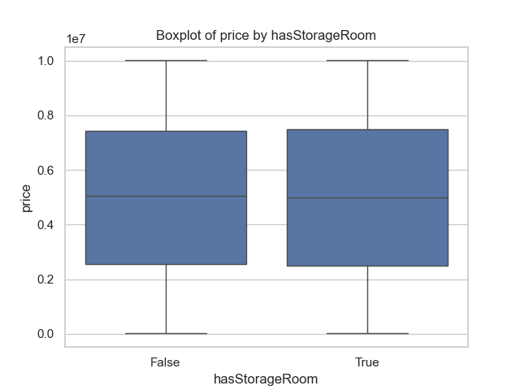
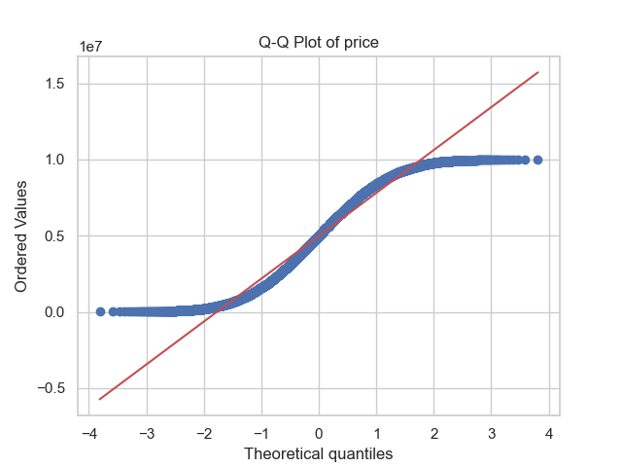
Testing Hypothesis #1
The Q-Q plot shows the distribution of the price variable. If the points fall along the red diagonal line, it indicates that the data follows a normal distribution.
In this plot, the points closely follow the line, suggesting that the price data is approximately normally distributed. However, there are slight deviations at the tails, which may indicate minor skewness in the distribution.
The boxplot compares the prices of houses based on whether they have a storage room (True) or not (False).
The median prices for both groups are quite similar, with no clear visual indication of a significant difference. The interquartile ranges and overall distribution of prices appear almost identical for both groups, suggesting that the presence of a storage room does not drastically affect the price.
However, this visual result must be confirmed by performing the t-test to assess the statistical significance of the difference.

Slide 18
Testing Hypothesis #1
1.Mann-Whitney U Test Results:
U-statistic = 12,549,713
p-value = 0.7282
Group means:
Mean price for houses with a storage room: approximately 4,993,447
Mean price for houses without a storage room: approximately 4,993,447
2.p-value Interpretation:
A p-value of 0.7282 is much higher than the standard significance level of 0.05. This indicates that there is no significant difference in price between houses with and without a storage room.
Given the high p-value, the result is not statistically significant, and we fail to reject the null hypothesis. This means that the presence of a storage room does not have a significant impact on house prices.
3.Chart Observations:
The Q-Q Plot shows that the price data is not normally distributed, with a clear deviation in the tails.
The Boxplot reveals that the price distribution between houses with and without a storage room is almost identical. The medians and interquartile ranges are similar, indicating no substantial difference in price distribution between the two groups.
4.Conclusion:
Overall, based on the Mann-Whitney U test results and visual analysis, there is no significant impact of having a storage room on house prices, as the mean prices are nearly identical. Therefore, the hypothesis that houses with storage rooms have higher prices is not supported.

Slide 19
Testing Hypothesis #1
1.Null Hypothesis (H₀):
There is no significant difference in the average price between houses with and without a storage room.
2.p-value result:
The p-value from the Mann-Whitney U test is 0.7282.
3.Conclusion:
Since the p-value is greater than 0.05, we fail to reject the null hypothesis.
This indicates that there is no statistically significant difference in house prices based on whether a house has a storage room.
4.Explanation:
Although we hypothesized that houses with storage rooms might be more expensive, the statistical results do not provide sufficient evidence to support this claim.
As a result, we fail to reject the null hypothesis, indicating that the presence of a storage room does not significantly impact house prices in this analysis.

Slide 20
Hypothesis #2
Analysis Type: chi-Square
Variables:
hasStormProtector (Nominal): Whether the house has a storm protector.
category (Nominal): House category (e.g., Basic).
H₀ (Null Hypothesis):
There is no significant association between the presence of a storm protector and the house category (Basic, etc.).
Hₐ (Alternative Hypothesis):
There is a significant association between the presence of a storm protector and the house category.

Slide 21
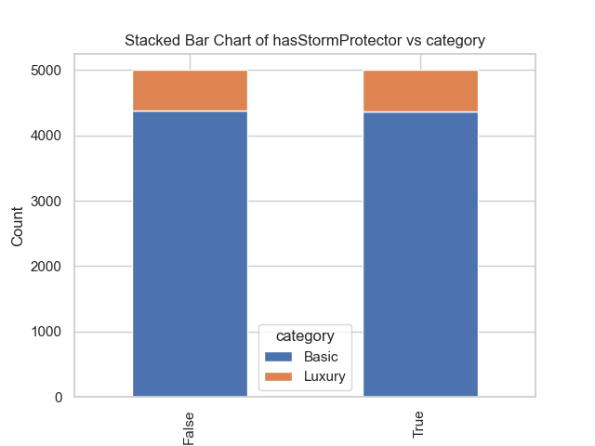
Testing Hypothesis #2
The chart is a stacked bar chart displaying the relationship between hasStormProtector (whether the house has storm protection) and category (house category). It shows the distribution of different house categories based on the presence or absence of storm protection.
In the chart:
False (no storm protection) and True (with storm protection) are represented on the x-axis, indicating whether a house has storm protection.
The y-axis represents the number of houses.
The two colors in the chart represent different house categories: blue indicates "Basic" houses, and orange indicates "Luxury" houses.
The number of "Basic" houses is significantly higher than the number of "Luxury" houses, regardless of whether the house has storm protection.
In both groups (with and without storm protection), approximately 90% of the houses fall under the "Basic" category, while around 10% fall under the "Luxury" category.
Visually, the presence or absence of storm protection does not appear to have a significant impact on the distribution of house categories, as the distribution patterns between the two groups are quite similar.

Slide 22
Testing Hypothesis #2
Results Explanation:
A Chi-Square Test was conducted to analyze the association between hasStormProtector (whether the house has a storm protector) and category (house category).
The contingency table shows the number of houses classified as "Basic" and "Luxury" with and without storm protectors:
For houses without a storm protector, there are 4372 "Basic" houses and 629 "Luxury" houses.
For houses with a storm protector, there are 4363 "Basic" houses and 636 "Luxury" houses.
The expected frequencies are very close to the actual observed counts. These are the values we would expect if there is no association between the two variables.
For houses without storm protectors, the expected number of "Basic" houses is 4368.37, while the actual number is 4372.
The expected number of "Luxury" houses is 632.63, while the actual number is 629.
The Chi-Square statistic is 0.0354, the p-value is 0.85079, and the degrees of freedom is 1.
Interpretation of the values:
The small Chi-Square statistic indicates a minor difference between the observed and expected counts.
The p-value is much higher than the common significance level (such as 0.05), indicating that there is not enough evidence to suggest a significant association between "hasStormProtector" and "category."
The close match between the expected and observed frequencies further confirms the weak association between the two variables.

Slide 23
Testing Hypothesis #2
Statistical Decision:
The Chi-Square statistic is 0.0354, with a p-value of 0.85079.
Since the p-value is significantly greater than 0.05, we fail to reject the null hypothesis.
Chi-Square Test Conclusion:
Null Hypothesis (H₀): There is no significant association between the presence of a storm protector and the house category (Basic or Luxury).
Alternative Hypothesis (Hₐ): There is a significant association between the presence of a storm protector and the house category.
Final Conclusion:
Based on the analysis, there is no significant association between the presence of a storm protector and the house category.
Therefore, we cannot conclude that having a storm protector has any impact on whether a house is classified as "Basic" or "Luxury."
The observed data suggests that the presence or absence of a storm protector does not significantly affect the distribution of house categories.

Slide 24
Hypothesis #3
Analysis Type: ANOVA
Variables:
price (Ratio): The price of the house.
cityPartRange (Ordinal): The range of the city part.
Null Hypothesis (H₀):
There is no significant difference in the average price across different city part ranges.
Alternative Hypothesis (Hₐ):
There is a significant difference in the average price across different city part ranges.

Slide 25
Testing Hypothesis #3
The Q-Q Plot visualizes the distribution of the variable "price" in comparison to a normal distribution. The ordered values of "price" are plotted against theoretical quantiles of a standard normal distribution.
The blue dots represent the ordered values of the "price" variable.
The red line represents the expected distribution if "price" were normally distributed.
The closer the points are to the red line, the more the data follows a normal distribution.
Interpretation:
For the most part, the data points follow the red line reasonably well, but there are some deviations at the lower and higher ends (the tails). This indicates that "price" does not perfectly follow a normal distribution but is approximately normal.
Since ANOVA assumes normality, it is important to consider these deviations when interpreting the results of the analysis.

Slide 26
Testing Hypothesis #3
Test Results:
Normality Test (Anderson-Darling):
Statistic = 105.6779, Critical Value = 0.7870.
The test indicates that the variable "price" does not follow a normal distribution, as reflected by the deviation of data points in the Q-Q plot. Therefore, we used the Kruskal-Wallis Test, a non-parametric alternative to ANOVA, which does not require normality.
Kruskal-Wallis Test Result:
Statistic = 4.3945, p-value = 0.8836.
This high p-value suggests that there is no significant difference in the mean price across different city part ranges.
Explanation:
The p-value (0.8836) is much greater than the commonly used significance level (0.05). Therefore, we do not have enough evidence to reject the null hypothesis.
This means that, based on the data, the average price of houses does not differ significantly across the various city part ranges.

Slide 27
Testing Hypothesis #3
Based on the test results:
The p-value = 0.8836 from the Kruskal-Wallis test is greater than 0.05, which is the typical significance level.
Therefore:
We fail to reject the null hypothesis.
This means that there is no significant difference in the average price across the different city part ranges in the dataset.
Conclusion:
Null Hypothesis (H₀): There is no significant difference in the mean price across different city part ranges.
Final Decision:
Fail to Reject H₀: The data suggests that the average price of houses does not vary significantly between the city part ranges.

Slide 28
Hypothesis #4
Analysis Type: Regression Analysis
Variables:
price (Dependent - Ratio): The price of the house.
squareMeters (Independent - Ratio): The size of the house in square meters.
Null Hypothesis (H₀):
There is no significant linear relationship between the size of the house (square meters) and its price.
Alternative Hypothesis (Hₐ):
There is a significant linear relationship between the size of the house (square meters) and its price.

Slide 29
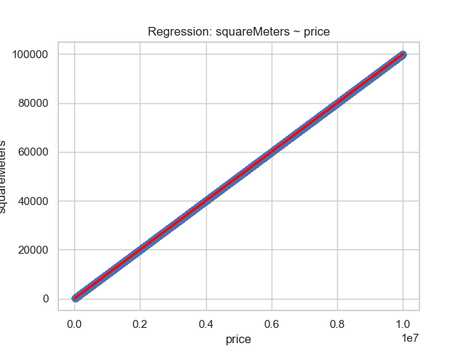
Testing Hypothesis #4
The graph shows the relationship between squareMeters (size of the house) and price (house price) using a linear regression model. The red line represents the regression line, which predicts the price based on the size of the house.
Observations from the Plot:
The data points are closely aligned along the regression line, indicating a strong positive linear relationship between the size of the house and its price.
As the square meters increase, the price increases in a proportional manner, which suggests a direct correlation between house size and price.
This visualization strongly suggests that larger houses tend to have higher prices, as the data points almost perfectly align with the regression line.

Slide 30
Testing Hypothesis #4
Normality Test Results:
The Anderson-Darling test for normality was conducted for both variables. The price and squareMeters data do not follow a normal distribution based on the high statistic values (105.6779 and 105.6847) and their critical values. Therefore, caution should be taken when interpreting the results of this regression model.
Regression Results:
Slope: 0.0100 — This indicates that for every 1 unit increase in price, the squareMeters increases by 0.01. This suggests a positive linear relationship between the price and house size.
Intercept: -64.5449 — When the price is 0, the predicted size of the house would be negative, which is not realistic, but this is typical in linear regression models when dealing with non-zero intercepts.
R-squared: 1.0000 — The R-squared value is 1, indicating a perfect fit. This means that 100% of the variability in house size can be explained by the price.
P-value: 0.000000000000000 — The p-value is extremely low, meaning the results are statistically significant. This suggests that price has a significant impact on squareMeters.
Standard Error: 0.0000 — The standard error is very low, suggesting a high level of precision in the estimated relationship.

Slide 31
Testing Hypothesis #4
Null Hypothesis (H₀): There is no significant linear relationship between house price (price) and house size (squareMeters).
Alternative Hypothesis (Hₐ): There is a significant linear relationship between house price (price) and house size (squareMeters).
Conclusion:
Based on the regression analysis results, the p-value is 0.000, which is less than the threshold of 0.05.
Therefore, we reject the null hypothesis (H₀) and conclude that there is a statistically significant linear relationship between the size of the house (square meters) and its price.
This means that price has a significant impact on the square meters of the house, indicating that larger houses tend to be priced higher.

Slide 32
(NOT MANDATORY)
Interesting results
BONUS – 5 points

Slide 33
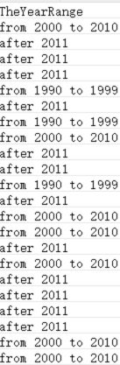
Interesting Hypothesis (NOT MANDATORY)
preparation:
In order to observe the relationship between the area of a house and its age more intuitively, and explore whether the development of the times and the acceleration of the pace of life may affect the area of a house, we have added a variable to our dataset that reflects the range of ages, as shown in the figure on the right.

Slide 34
Interesting Hypothesis (NOT MANDATORY)
Analysis Type: ANOVA
Variables:
squareMeters (Ratio): SquareMeters.
TheYearRange (Ordinal): The Range of the house was built.
Hypothesis:
H₀ (Null Hypothesis): There is no significant difference in the average house size (square meters) across different year ranges.
Hₐ (Alternative Hypothesis): There is a significant difference in the average house size (square meters) across different year ranges.

Slide 35
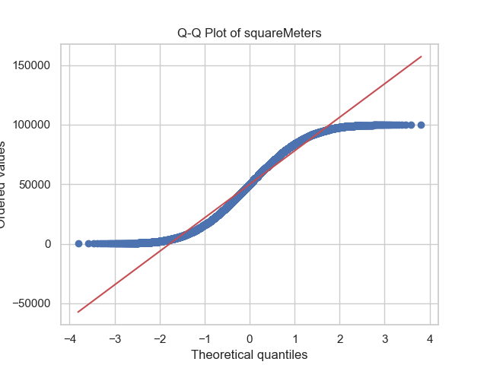
Interesting Hypothesis (NOT MANDATORY)
The Q-Q Plot visualizes the distribution of the variable "SquareMeters" (house size) in comparison to a normal distribution. The ordered values of "SquareMeters" are plotted against the theoretical quantiles of a standard normal distribution.
The blue dots represent the ordered values of the "SquareMeters" variable.
The red line represents the expected distribution if "SquareMeters" were normally distributed.
The closer the points are to the red line, the more the data follows a normal distribution.
Interpretation:
For the most part, the data points follow the red line reasonably well, but there are deviations at the lower and higher ends (the tails). This indicates that "SquareMeters" does not perfectly follow a normal distribution but is approximately normal. Since certain tests, like regression analysis, assume normality, it is important to take these deviations into account when interpreting the results.

Slide 36
Interesting Hypothesis (NOT MANDATORY)
Test Results:
Normality Test (Anderson-Darling):
Statistic = 105.6847, Critical Value = 0.7870.
The test indicates that the variable "squareMeters" does not follow a normal distribution, as shown by the deviation in the Q-Q plot. Therefore, we used the Kruskal-Wallis Test, a non-parametric alternative to ANOVA, which does not assume normality.
Kruskal-Wallis Test Result:
Statistic = 5.0465, p-value = 0.0802.
This p-value suggests that there is no statistically significant difference in the mean house sizes ("squareMeters") across the different year ranges ("TheYearRange").
Explanation:
The p-value (0.0802) is higher than the common significance level (0.05). Therefore, we do not have sufficient evidence to reject the null hypothesis.
This means that, based on the data, the average house size ("squareMeters") does not differ significantly across the various year ranges ("TheYearRange").

Slide 37
Interesting Hypothesis (NOT MANDATORY)
Null Hypothesis (H₀): There is no significant difference in the average house size ("squareMeters") across the groups of "TheYearRange".
Alternative Hypothesis (Hₐ): There is a significant difference in the average house size ("squareMeters") across the groups of "TheYearRange".
Decision: Based on the results of the Kruskal-Wallis Test, the p-value is 0.0802, which is greater than the common significance level of 0.05. Therefore, we fail to reject the null hypothesis.
Conclusion: There is no significant difference in the average house size across the different year ranges in the dataset. This indicates that the size of the house is not significantly affected by the year range of the house construction.

Slide 38
End

